Slide 1







R Fundamentals Bootcamp
You should have R & RStudio installed
https://sites.northwestern.edu/researchcomputing/resources/r-and-rstudio/
We start at 9:05am
Get some coffee!
Download the materials from GitHub
https://github.com/nuitrcs/R-fundamentals-winter-workshop
Get help from Northwestern IT Research Computing and Data Services!
Get 1-1 help from us! – bit.ly/rcdsconsult
Bring Your Own Data (BYOD) working groups – bit.ly/byod_groups
Collaborative Project Support – bit.ly/collaborative_project_support

Slide 2
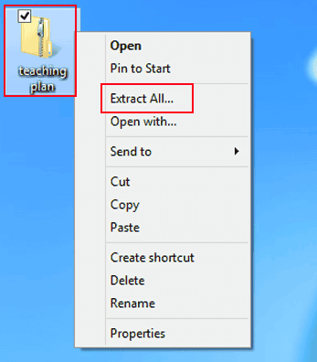
How to Unzip Files in Windows
Follow this link -
https://www.lifewire.com/unzip-files-windows-11-8425832
Click on “Extract All”

Slide 3
Research Computing and Data Services
Instructor and TAs:
Emilio Lehoucq
Arne Holverscheid
Eileen Wu
Anthony Pulvino
Northwestern IT

Slide 4
What to expect this week
Please be ready to start each session on time. We have a lot to cover! ⏰
We will follow this schedule as close as possible:
9am – 10am: first session
10am – 10:30am: break
10:30am – 11:30am: second session
11:30am – 1pm: lunch break
1pm – 2pm: third session
2pm – 2:30pm: break
2:30pm – 3:30pm: fourth session
3:30 – 3:35: break
3:35pm – 4:00pm: Q&A

Slide 5
LET’S KEEP THIS WORKSHOP INTERACTIVE!
Everything that you need is already in the materials. For the most part, you don’t need to take notes.
While I code, I encourage you to type alongside.
Starting tomorrow, there are exercises all the time.
Active participation:
Ask questions in the chat while I teach (e.g., if the code is not working for you). Our experienced TA will help you.
I’ll be stopping regularly to ask for questions (e.g., clarifying a concept or asking me to explain something again). During that time, you can ask questions in the chat or raise your virtual hand, and I’ll let you know when you can unmute to ask your question.*
I will host Q&A sessions 3:35pm – 4pm at the end of each day to answer any leftover questions or clarify anything.
* I may reassess this.

Slide 6
IF MY INTERNET GOES OUT, YOU GET A 5-MINUTE BREAK AND WE’LL MEET BACK IN THE SAME ZOOM ROOM KEEP AN EYE ON YOUR EMAIL JUST IN CASE (SHOULDN’T happen, BUT BETTER SAFE THAN SORRY)

Slide 7
SYMBOLS FOR THE EXERCISES
✅ = I’M DONE / READY TO CONTINUE
❌ = NEED SOME MORE TIME

Slide 8

Who are you?
Done any coding before?
Majored in?
Love cats?
Feeling apprehensive?
Feeling confident?
Used R before?

Slide 9
What are we doing today?
Learning concepts that you need for R
1
Getting to know R and RStudio
2

Slide 10


ASK QUESTIONS!
ASK FOR a USE CASE
Don't worry—we're all learning!
We're going to cover a lot. Learning to program takes time and can be hard at first.
It's okay if you don't understand or remember everything. As you code, you'll get better and more comfortable.
Try to have fun during this workshop and don't be afraid to play around with code!

Slide 11

Think before coding!
During the exercises, you'll have the inclination to start coding immediately... but wait!
Before coding, think about the problem and...
Define the task that you're trying to accomplish
Identify the input and the output
Break the task into subtasks
Order the subtasks logically
You can even use a good, old piece of paper!

Slide 12

Help!
Help!
Every programmer needs help. As you code, these will be your best friends:
Documentation – R help
Stackoverflow.com
Github.com
Google
LLMs (Microsoft Bing/Copilot, ChatGPT, Google Gemini)
Your colleagues
Our free consult service: bit.ly/rcdsconsult

Slide 13
Double click on the .RProj file to open the project in RStudio
Let’s start !

Slide 14
Concepts we will cover today
Terminology
Data Types
Variables
Vectors
Functions
File systems
Data Frames
Notes:
Some concepts we will be learning today

Slide 15
Concepts we will cover today
Terminology
Data Types
Variables
Vectors
Functions
File systems
Data Frames
Notes:
Some concepts we will be learning today

Slide 16
terminology
Programming languages
consoles
guis

Slide 17
GUI
GUI: Graphical User Interface: Programs on your computer with buttons and other visual elements; you can interact with a mouse or touchscreen
PowerPoint, Word, Excel, SPSS, Zoom, web browser, etc.
Notes:
They can be used for analysis – but suffer from a big problem!

Slide 18

Problem: How do we tell others what we did? How do we keep track of what we did for ourselves?

Slide 19
Programming Languages
A system for giving instructions to a computer (writing code)
Specific words and characters in a specific order

Slide 20
Console
Console: Simple computer program where we type commands, one line at a time
They can run different programming languages
Launching R runs the R console
Type instructions at a prompt (>)
Used for basic operations and running other programs

Slide 21
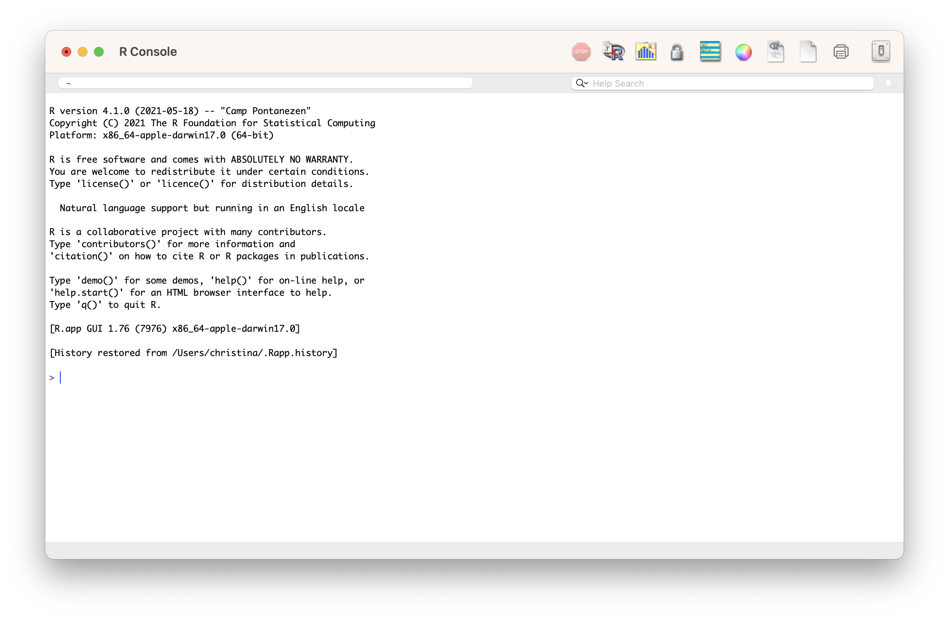
THE R Console
Notes:
Show a few math commands on the R console to show what it’s doing:
2 + 2

Slide 22

But that’s sometimes annoying and inconvenient… and how do we record what we did?

Slide 23
An IDE makes it easy and convenient to write code!
IDE: Integrated Development Environment: A GUI that helps make writing computer programs easier (e.g., RStudio)

Slide 24

R vs RStuDio

Slide 25
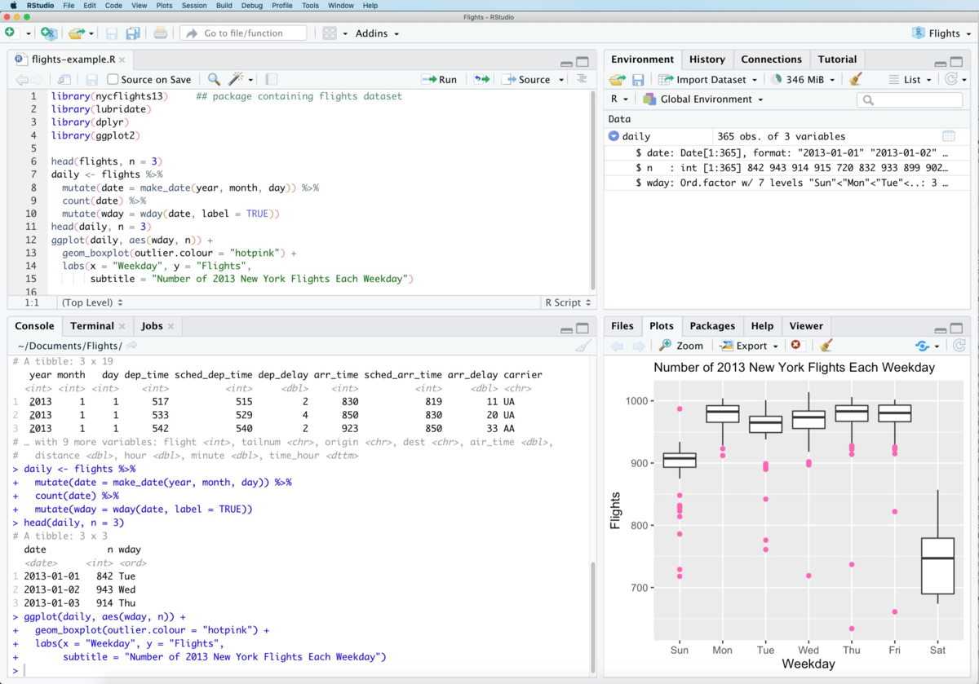
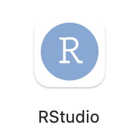
R vs RStuDio

Slide 26
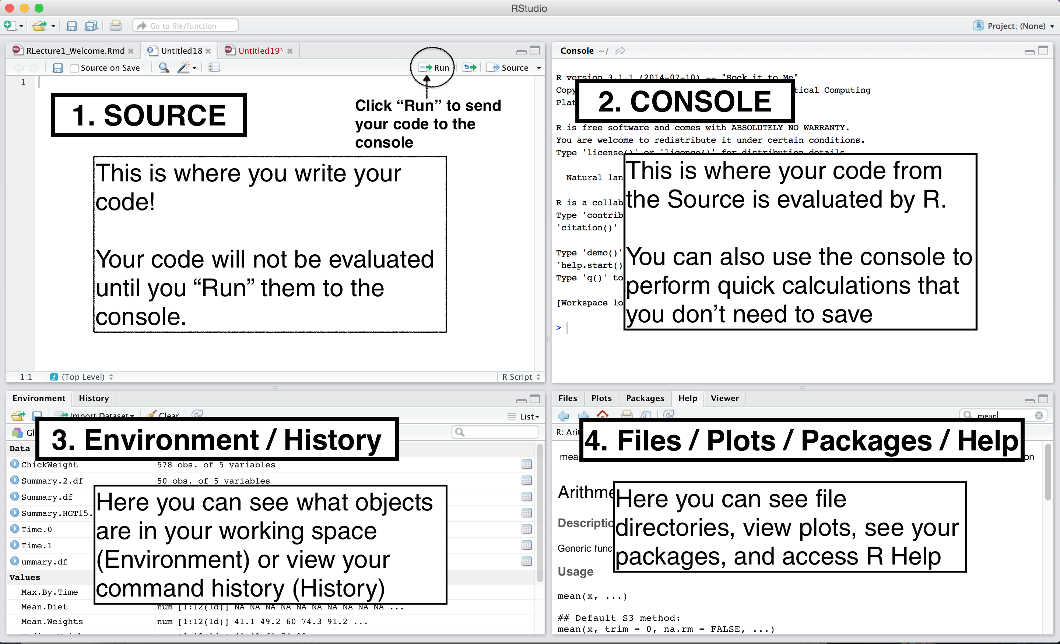
Rstudio pane layout
Note: Your RStudio panel layout won’t have a script open, so the source pane might be minimized
Notes:
Just a layout – describe in demo on next slide

Slide 27
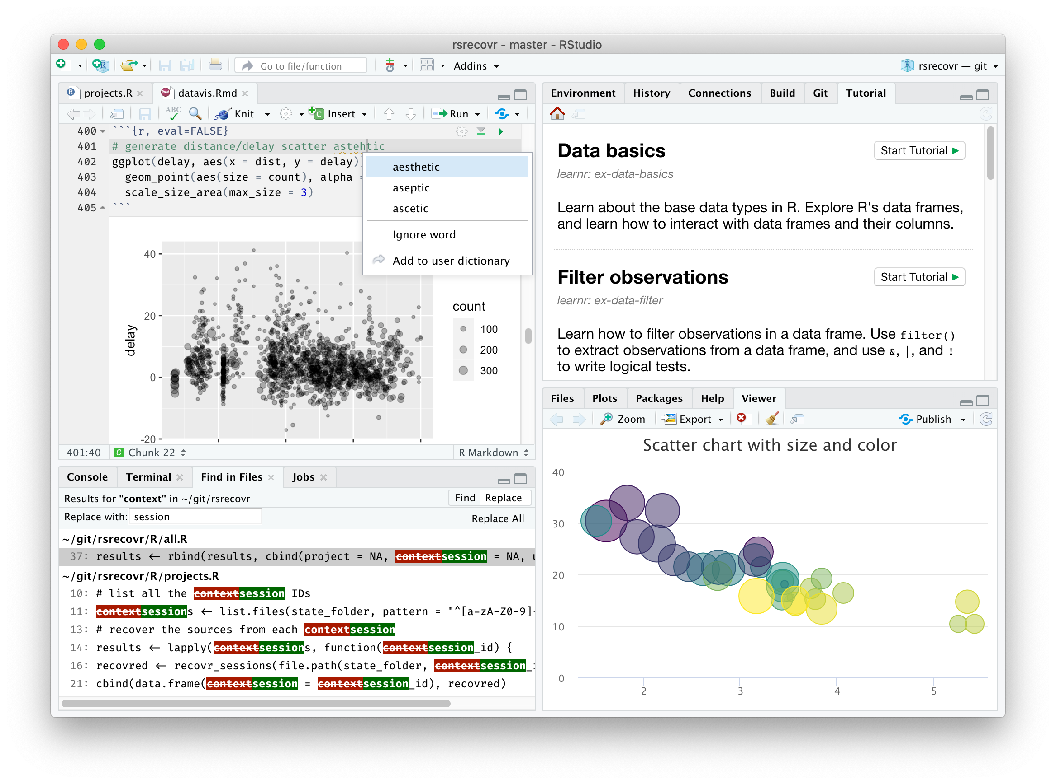
Let’s open RSTUDIO

Slide 28

Your Quest: Should you choose to accept!
Quest 1.
Type some math equations in the console and get answers
> Press enter at the end of a line to run the command
Quest 2.
Open the file script1.R in Rstudio.
You may do so by following either path:
(1) File menu > Open File…
(2) Go to the File Panel in Rstudio, click on the File tab and then click on the file to open it

Slide 29

Everything that is an R command still has to run through the R console in RStudio
Some buttons and menus write code for us!

Slide 30

YAY!
We can keep a full record of everything we do!
Don’t have to write down instructions like:
open this menu, pick this option, check the third button, etc.
where the steps might vary with software version, operating system, etc..

Slide 31


YAY!
We can keep a full record of everything we do!
Don’t have to write down instructions like:
open this menu, pick this option, check the third button, etc.
where the steps might vary with software version, operating system, etc..
Means we can do reproducible science and research
Does not mean that this happens automatically!

Slide 32
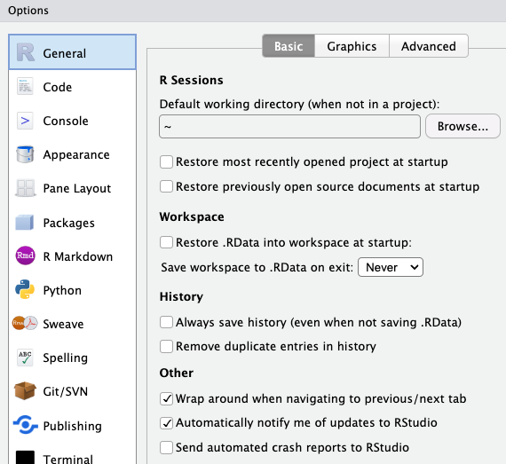
SUGGESTED SETTINGS
We want scripts to have everything...
To avoid confusion, we suggest that you click on Tools (in the top bar), then click on Global Options, uncheck some of the boxes, and then click Apply. This is what we recommend:

Slide 33
Quiz Time!
Which of these are true?
A: RStudio is a programming language
B: R and RStudio are the same program
C: RStudio is an IDE
D: RStudio is a GUI
E: R automatically makes our code reproducible
F: All R commands have to run through the R console

Slide 34
Concepts we will cover today
Terminology
Data Types
Variables
Vectors
Functions
File systems
Data Frames
Notes:
Some concepts we will be learning today

Slide 35
Data types & Boolean operators
Head back to RStudio...script2.R
Strings, numerics
true false
conditional expressions

Slide 36
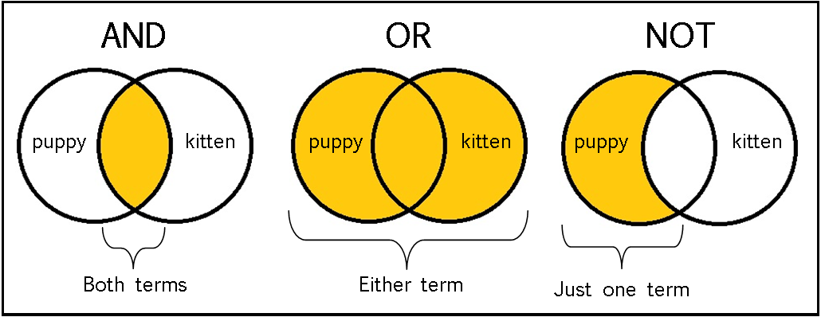
Boolean / Logical operators:

Slide 37
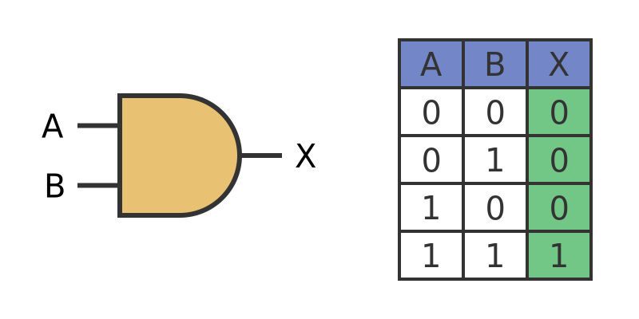
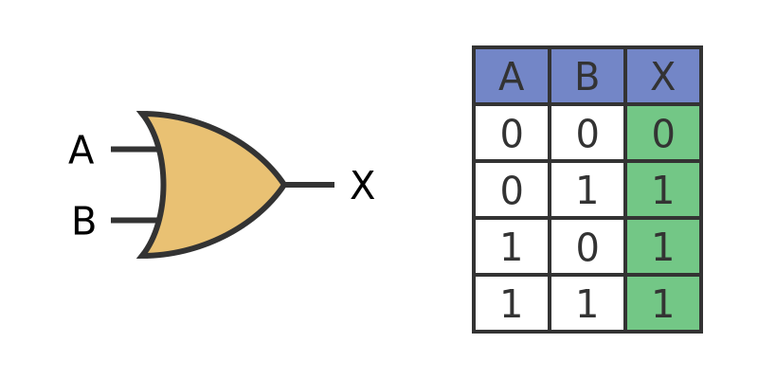
Boolean / Logical operators:
AND (&) – both conditions must be TRUE
OR (|) – at least 1 condition must be TRUE
Example:
Cond_1 – Today is snowing
Cond_2 – I am happy today
Cond_1 & Cond_2 evaluates to ____ ?
Cond_1 | Cond_2 evaluates to ____ ?

Slide 38
Quiz Time!
Which of these are true?
A: "\n" is an empty string
B: (TRUE & FALSE) | (FALSE | TRUE)
C: TRUE == 1
D: “Dog” == “dog”
E: "this is a valid character data'
F: The value false can be represented as: FALSE, F, or false

Slide 39
Concepts we will cover today
Terminology
Data Types
Variables
Vectors
Functions
File systems
Data Frames
Notes:
Some concepts we will be learning today

Slide 40
variables
Assigning values
Storing values
Variable names

Slide 41

Variables
A variable can store any value you assign to it.. (just like variables in algebra)
3

Slide 42
Variables
A variable can store any value you assign to it..
“dog”

Slide 43
Variables
A variable can store any value you assign to it..
TRUE

Slide 44
Variables
Every variable has a name
x

Slide 45
Variables
x
You can retrieve the value stored in the variable by calling it by its name
TRUE

Slide 46
Variables
Assigning values to variables
x = 3
x <- 3
Variable name
"Left hand side"
Value
"Right hand side"
Assignment
operator

Slide 47
Variables
x <- 3
<- is preferred in R

Slide 48
Variables
x <- 3 + 5
x
x is 8

Slide 49
Variables
x <- 3
x + 5
x
x is 3

Slide 50
Variables
x <- 3
x <- x + 5
x
x is 8

Slide 51
Variables
x <- 3
y <- 5
x <- x + y
x
x is 8

Slide 52
Variables
x <- 3
y <- 5
x <- x + y
y <- 7
x
x is 8

Slide 53
Concepts we will cover today
Terminology
Data Types
Variables
Vectors
Functions
File systems
Data Frames
Notes:
Some concepts we will be learning today

Slide 54
Vectors
Storing multiple values
Indexing

Slide 55
Storing Multiple Values Together
We combine them with c() into a vector
x <- c(2, 4, 7, 8)
In R, a vector is a list of items of the same data-type.

Slide 56
Assigning a vector as a value to variable x
c(2, 4, 7, 8)
x

Slide 57
Indexing Values in a Vector
Retrieving single elements from a vector
Indexing –giving a unique number to each element based on its position in the list
Indices in R start from 1
Position/Index: 1 2 3 4
x <- c(2, 4, 7, 8)

Slide 58
Selecting elements from a vector
elements of a vector can be selected using [ ]
The position/index goes inside [ ]
x <- c(2, 4, 7, 8)
x[1] stores 2
x[2] stores 4
Note that ( ) usually denotes a function call, while [ ] denotes index/subset in R

Slide 59
changing a variable
x <- c(2, 4, 7, 8)
x[2] <- 6
x
2, 6, 7, 8

Slide 60
Changing a variable
x <- c(2, 4, 7, 8)
x <- 6
x
6
R doesn’t care what’s in the variable “box”!

Slide 61

Back to RStudio…
Open script3.R

Slide 62
Concepts we will cover today
Terminology
Data Types
Variables
Vectors
Functions
File systems
Data Frames
Notes:
Some concepts we will be learning today

Slide 63
functions
define a function
call a function
Input parameters
return values

Slide 64
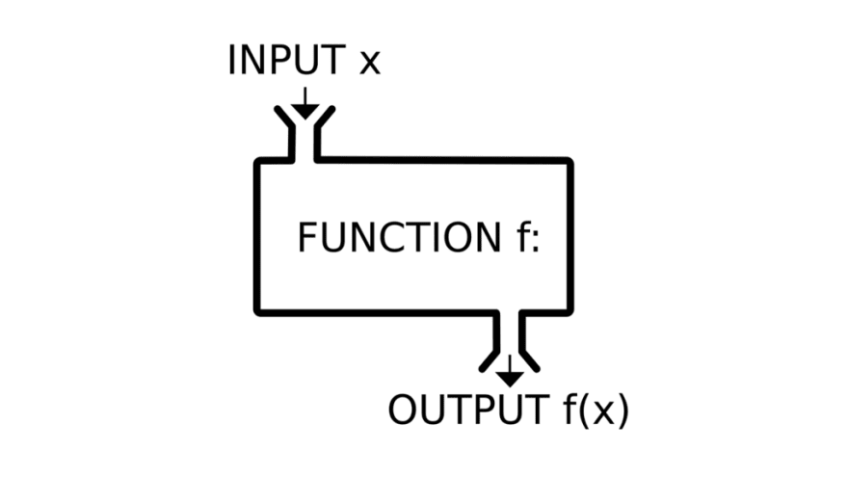
Functions in programming ~ similar to math functions
f(x) = y
Takes input values, also called parameters or arguments
Returns an output value, also called a return value
R functions usually don't alter their input values (but they sometimes do!)

Slide 65
Why should you use functions?
Pieces of code designed to perform specific tasks
You can re-use them multiple times without re-writing the same code
They help you organize your code into manageable chunks
You can use them just knowing their input and output
→ They help you write code that is clearer and less error prone. They also help you conserve your valuable brain power

Slide 66
Let’s look at a useful function..
read.csv(file, header = TRUE, sep = ",", quote = "\"",
dec = ".", fill = TRUE, comment.char = "", ...)

Slide 67
Defining functions
Functions have names
read.csv(file, header = TRUE, sep = ",", quote = "\"",
dec = ".", fill = TRUE, comment.char = "", ...)

Slide 68
Defining functions
Functions can be called with their names using ( )
read.csv(file, header = TRUE, sep = ",", quote = "\"",
dec = ".", fill = TRUE, comment.char = "", ...)

Slide 69
Defining functions
Functions take input parameters or arguments inside ( )
read.csv(file, header = TRUE, sep = ",", quote = "\"",
dec = ".", fill = TRUE, comment.char = "", ...)

Slide 70
Defining functions
Function parameters also have names (parameter names)
read.csv(file, header = TRUE, sep = ",", quote = "\"",
dec = ".", fill = TRUE, comment.char = "", ...)

Slide 71
Defining functions
Some function parameters have default values
read.csv(file, header = TRUE, sep = ",", quote = "\"",
dec = ".", fill = TRUE, comment.char = "", ...)
These are the values the function parameter will take if no values are provided for it by the user

Slide 72
Defining functions
However, some parameters are required parameters!
read.csv(file, header = TRUE, sep = ",", quote = "\"",
dec = ".", fill = TRUE, comment.char = "", ...)
These parameter values need to be provided by the user

Slide 73
Defining functions
Some functions also have additional undefined parameters
read.csv(file, header = TRUE, sep = ",", quote = "\"",
dec = ".", fill = TRUE, comment.char = "", ...)
These are additional values that can be taken by this function but are not explicitly listed in the function definition.
We will see some examples later.

Slide 74
Defining functions
Putting it all together
read.csv(file, header = TRUE, sep = ",", quote = "\"",
dec = ".", fill = TRUE, comment.char = "", ...)
Functions have names, they can be called with ().
Functions take input parameters, which also have parameter names.
Some parameters are required, some have default values, and some others are additional (hidden) parameters.

Slide 75
Calling functions
Functions are called as: function_name(input parameters/args)

Slide 76

Calling functions
Functions are called as: function_name(input parameters/args)
How does R know which value to assign to which input parameter??

Slide 77

Calling functions
Functions are called as: function_name(input parameters/args)
How does R know which value to assign to which input parameter??
by name
by position
by name and position

Slide 78
Calling functions
Defining parameter values by Name
read.csv(file, header = TRUE, sep = ",", quote = "\"",
dec = ".", fill = TRUE, comment.char = "", ...)
read.csv(file=“results.txt”,
header=TRUE,
sep=“\t”)

Slide 79

Calling functions
Defining parameter values by Name
read.csv(file, header = TRUE, sep = ",", quote = "\"",
dec = ".", fill = TRUE, comment.char = "", ...)
read.csv( sep=“\t”,
file=“results.txt”,
header=TRUE)

Slide 80
Calling functions
Defining parameter values by Position
read.csv(file, header = TRUE, sep = ",", quote = "\"",
dec = ".", fill = TRUE, comment.char = "", ...)
read.csv(“results.txt”, TRUE, “\t”)

Slide 81
Calling functions
Defining parameter values by Position
read.csv(file, header = TRUE, sep = ",", quote = "\"",
dec = ".", fill = TRUE, comment.char = "", ...)
1, 2, 3
read.csv(“results.txt”, TRUE, “\t”)

Slide 82
Calling functions
Defining parameter values by Position & Name
read.csv(file, header = TRUE, sep = ",", quote = "\"",
dec = ".", fill = TRUE, comment.char = "", ...)
read.csv(file=“results.txt”, TRUE, “\t”)

Slide 83
Calling functions
Defining parameter values by Position & Name
read.csv(file, header = TRUE, sep = ",", quote = "\"",
dec = ".", fill = TRUE, comment.char = "", ...)
read.csv(file=“results.txt”, TRUE, “\t”)
Match all named arguments first,

Slide 84
Calling functions
Defining parameter values by Position & Name
read.csv(file, header = TRUE, sep = ",", quote = "\"",
dec = ".", fill = TRUE, comment.char = "", ...)
read.csv(file=“results.txt”, TRUE, “\t”)
Match all named arguments first,
Match positions in order – 1

Slide 85
Calling functions
Defining parameter values by Position & Name
read.csv(file, header = TRUE, sep = ",", quote = "\"",
dec = ".", fill = TRUE, comment.char = "", ...)
read.csv(file=“results.txt”, TRUE, “\t”)
Match all named arguments first,
Match positions in order – 1
Match positions in order – 2

Slide 86
Calling functions
Defining parameter values by Position & Name
read.csv(file, header = TRUE, sep = ",", quote = "\"",
dec = ".", fill = TRUE, comment.char = "", ...)
read.csv(header=TRUE, “results.txt”, “\t”)
Let’s try another example..

Slide 87
Calling functions
Defining parameter values by Position & Name
read.csv(file, header = TRUE, sep = ",", quote = "\"",
dec = ".", fill = TRUE, comment.char = "", ...)
read.csv(header=TRUE, “results.txt”, “\t”)
Named arguments matched!

Slide 88
Calling functions
Defining parameter values by Position & Name
read.csv(file, header = TRUE, sep = ",", quote = "\"",
dec = ".", fill = TRUE, comment.char = "", ...)
read.csv(header=TRUE, “results.txt”, “\t”)
Named arguments matched!
Position 1 matched to first leftover argument

Slide 89
Calling functions
Defining parameter values by Position & Name
read.csv(file, header = TRUE, sep = ",", quote = "\"",
dec = ".", fill = TRUE, comment.char = "", ...)
read.csv(header=TRUE, “results.txt”, “\t”)
Named arguments matched!
Position 1 matched to first leftover argument
Position 2 matched to second leftover argument

Slide 90
Quiz Time!
Will this function call work?
read.csv(file, header = TRUE, sep = ",", quote = "\"",
dec = ".", fill = TRUE, comment.char = "", ...)
read.csv("results.txt", sep="\t")
read.csv("results.txt", "\t")
read.csv("results.txt", TRUE, "\t")

Slide 91
Quiz Time!
Will this function call work?
read.csv(file, header = TRUE, sep = ",", quote = "\"",
dec = ".", fill = TRUE, comment.char = "", ...)
read.csv("results.txt", sep="\t")

Slide 92

Quiz Time!
Will this function call work?
read.csv(file, header = TRUE, sep = ",", quote = "\"",
dec = ".", fill = TRUE, comment.char = "", ...)
read.csv("results.txt", sep="\t")
Named argument sep is matched with value “\t”
First value “results.txt” is matched to first argument file

Slide 93
Quiz Time!
Will this function call work?
read.csv(file, header = TRUE, sep = ",", quote = "\"",
dec = ".", fill = TRUE, comment.char = "", ...)
read.csv("results.txt", "\t")

Slide 94

Quiz Time!
Will this function call work?
read.csv(file, header = TRUE, sep = ",", quote = "\"",
dec = ".", fill = TRUE, comment.char = "", ...)
read.csv("results.txt", "\t")
There are no named arguments
First value “results.txt” is matched to first argument file
Second value “\t” is matched to second argument header

Slide 95
Quiz Time!
Will this function call work?
read.csv(file, header = TRUE, sep = ",", quote = "\"",
dec = ".", fill = TRUE, comment.char = "", ...)
read.csv("results.txt", TRUE, "\t")

Slide 96
Quiz Time!
Will this function call work?
read.csv(file, header = TRUE, sep = ",", quote = "\"",
dec = ".", fill = TRUE, comment.char = "", ...)
read.csv("results.txt", TRUE, "\t")
There are no named arguments
First value “results.txt” is matched to first argument file
Second value TRUE is matched to second argument header
Third value “\t” is matched to third argument sep

Slide 97
Returning values
The output of a function is its return value
Function call
Return value
abs(-3)
3
But this output value is not saved!
How do we save this value??
We can save it by assigning the return value to a variable!
x <- abs(-3)

Slide 98
Back to RStudio…
Open script4.R

Slide 99
Concepts we will cover today
Terminology
Data Types
Variables
Vectors
Functions
File systems
Data Frames
Notes:
Some concepts we will be learning today

Slide 100
File systems
Absolute paths
Relative paths
Working directory

Slide 101
File paths
How do we tell R where our files are without using point and click interfaces?
Every file has an absolute path, which starts with the root
An absolute path makes no assumptions about your current location. It starts from the start of your hard drive and describes every step to get to a file. The root is that start—it's the starting point to organize all files on your computer

Slide 102
EXAMPLE OF AN ABSOLUTE PATH
Earth → North America → United States → Illinois → Evanston → Tech Drive → 2233

Slide 103
PC (Windows)
c:

Slide 104

C:\
PC (Windows)
c:
Program Files
Users
System

Slide 105
C:\Users\
PC (Windows)
c:
Program Files
Users
System
ritika
guest

Slide 106
C:\Users\ritika\
PC (Windows)
c:
Program Files
Users
System
ritika
guest
Documents
Desktop
Music
Photos

Slide 107
C:\Users\ritika\Documents\
PC (Windows)
c:
Program Files
Users
System
ritika
guest
Documents
Desktop
Music
Photos
dissertation
my_project

Slide 108

C:\Users\ritika\Documents\my_project
PC (Windows)
c:
Program Files
Users
System
ritika
guest
Documents
Desktop
Music
Photos
dissertation
my_project
data.csv
process.py
DRAFT.docx

Slide 109
C:\Users\ritika\Documents\my_project\data.csv
PC (Windows)
c:
Program Files
Users
System
ritika
guest
Documents
Desktop
Music
Photos
dissertation
my_project
data.csv
process.py
DRAFT.docx

Slide 110
/Users/ritika/Documents/my_project/data.csv
MacOS
/
Applications
Users
System
ritika
guest
Documents
Desktop
Music
Photos
dissertation
my_project
data.csv
process.py
DRAFT.docx

Slide 111
Absolute Paths
C:\Users\ritika\Documents\my_project\data.csv
/Users/ritika/Documents/my_project/data.csv
R is not able to understand normal Windows paths correctly because the "\" has special meaning - it is used as escape character to give following characters special meaning (\n for newline, \t for tab, etc.)
For windows:
Replace the "\" with "/" , or
Replace the "\" with "\\" , - an additional escape character escapes the special meaning

Slide 112
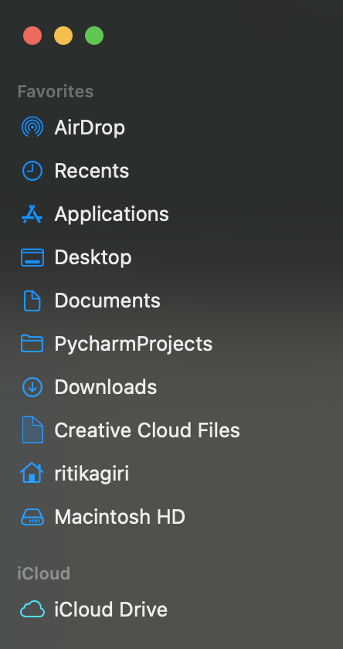
Home Directory
The home directory is a personal directory assigned to a user.
The root directory is the starting point of the whole computer, while the home directory is specific to a user.

Slide 113
Home Directory: C:\Users\ritika = ~
c:
Program Files
~
Users
System
ritika
guest
Documents
Desktop
Music
Photos
dissertation
my_project
data.csv
process.py
DRAFT.docx

Slide 114
~/Documents/my_project/data.csv
c:
Program Files
Users
System
ritika
guest
Documents
Desktop
Music
Photos
dissertation
my_project
data.csv
process.py
DRAFT.docx

Slide 115
Working Directory
A directory in the file system associated with a running process or program (aka "where you're working from")
>> Where R starts when looking for files
>> Uses Relative File Paths

Slide 116
EXAMPLE OF A RELATIVE PATH
Remember our absolute path: Earth → North America → United States → Illinois → Evanston → Tech Drive → 2233
The relative path (relative to Illinois) would be: Evanston → Tech Drive → 2233

Slide 117
Relative Path from Documents: my_project/data.csv
c:
Program Files
Users
System
ritika
guest
Documents
Desktop
Music
Photos
dissertation
my_project
data.csv
process.py
DRAFT.docx

Slide 118
From ritika:
c:
Program Files
Users
System
ritika
guest
Documents
Desktop
Music
Photos
dissertation
my_project
data.csv
process.py
DRAFT.docx
Notes:
Documents/my_project/data.csv

Slide 119
From ritika: Documents/my_project/data.csv
c:
Program Files
Users
System
ritika
guest
Documents
Desktop
Music
Photos
dissertation
my_project
data.csv
process.py
DRAFT.docx
Notes:
Documents/my_project/data.csv

Slide 120
.. means go up a level

Slide 121
From Desktop: ../Documents/my_project/data.csv
c:
Program Files
Users
System
ritika
guest
Documents
Desktop
Music
Photos
dissertation
my_project
data.csv
process.py
DRAFT.docx
Notes:
Documents/my_project/data.csv

Slide 122
From dissertation: ../my_project/data.csv
c:
Program Files
Users
System
ritika
guest
Documents
Desktop
Music
Photos
dissertation
my_project
data.csv
process.py
DRAFT.docx
Notes:
Documents/my_project/data.csv

Slide 123
How to find paths in your computer?
Mac:
Right click on a file > Get info ("Where")
Windows:
Right click on a file > Properties ("Location")
Or clicking in the box that contains the file name (above the list of files inside the folder)

Slide 124
But what is the Working Directory for R?
Default: home directory of the user (~)
RStudio Projects: the folder you associate with the project
>> You can set or change the working directory

Slide 125
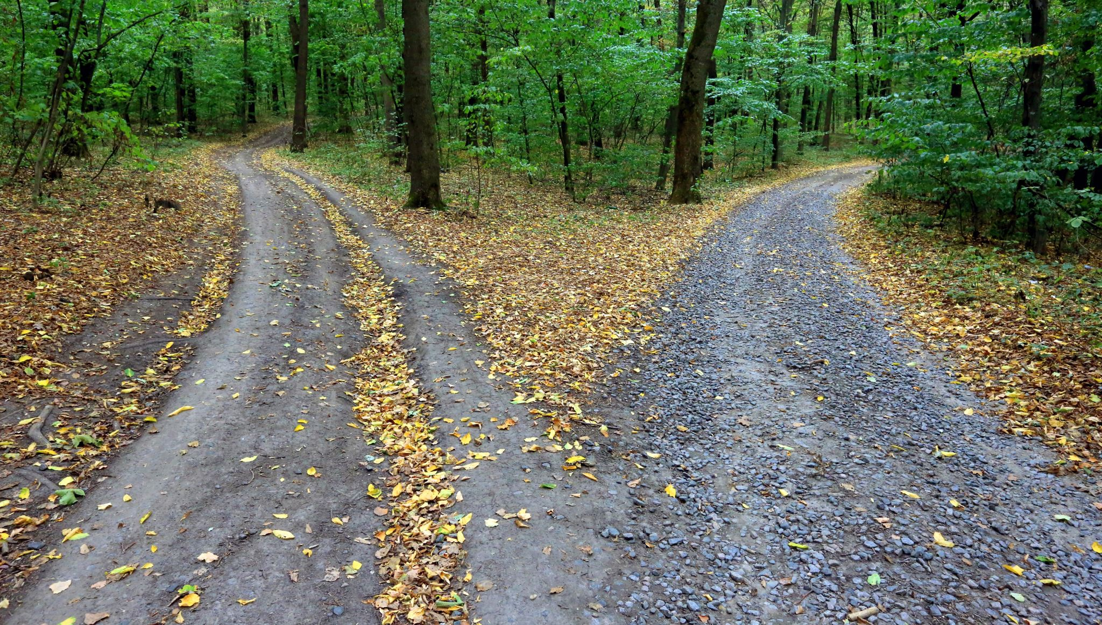
Why not just use absolute paths?

Slide 126
Store Project Files Together
project_directory
code
process_data.r
make_graphs.r
estimate_model.r
data
people.csv
exam1.csv
output
impact_plot.pdf
reports
chapter1.docx
working directory

Slide 127
Back to RStudio…
Open script5.R

Slide 128
Working with files
Reading, opening
Writing, saving

Slide 129
Some types of files that you can use within rstudio
Popular file formats used by researchers and R coders:
R script (.R)
R Markdown (.Rmd)
Quarto Markdown (.qmd)

Slide 130

R Markdown/QuaRTo
Back to RStudio...

Slide 131
Concepts we will cover today
Terminology
Data Types
Variables
Vectors
Functions
File systems
Data Frames
Notes:
Some concepts we will be learning today

Slide 132
Data frames
Rectangles of data
Rows
Columns
indexing

Slide 133

Rectangles of Data
variables/
features
observations
values

Slide 134
Rows: Observations
Person (or mouse, worm, etc.)
Country
Year
Run/trial of an experiment
Chemical
Sample

Slide 135
Columns: Variables
Measurements
Grouping/identification variable(s):
> trial/sample
> condition
> label for the observation (country name)

Slide 136
The $ operator
Access columns by names as:
data$column

Slide 137
Indexing
Access rows or columns by indexing as:
data [ rows , columns ]

Slide 138
Indexing : by POSITION
Provide the positions of the rows/cols you want:
data [ 1:10 , 2:5 ]
data [ , 2:5 ]
data [ 1:10 , ]
data [c(1,4) , c(3,5)]

Slide 139
Indexing : by POSITION
Provide the positions of the rows/cols you don’t want:
data [-1:-10, ]

Slide 140
Indexing : by NAME
Provide the names of the columns you want:
data [ , ”school” ]
data [ , c(”school”, “year”) ]

Slide 141
Indexing : by CONDITION
Filter rows by the conditions you want:
data[data$column == value, ]

Slide 142
Indexing : by CONDITION
Filter rows by the conditions you want:
data[data$column == value, ]
data[data$column > value, ]
data[data$column < value, ]

Slide 143
Indexing : by multiple CONDITIONs
Filter rows by combining conditions you want:
AND:
data[data$col1 >= x & data$col2 >= y , ]
OR:
data[data$col1 >= x | data$col2 >= y , ]

Slide 144
Missing values NA
Missing values are represented by a special value NA
is.na(x) – returns TRUE or FALSE
For example:
data[is.na(data$column), ]

Slide 145
Back to RStudio…
Open script6.R

Slide 146
Concepts we covered today
Terminology
Data Types
Variables
Vectors
Functions
File systems
Data Frames
Notes:
Some concepts we will be learning today

Slide 147



Resources
Resource to continue learning R
https://bookdown.org/ndphillips/YaRrr/
See you tomorrow
at 9.00am sharp!

